Slide 1
OBJECT DETECTION DEVICE FOR KIDS USING ESP32 CAM
IOMP ID:IT-25-11
B NIRANJAN KUMAR(22261A1208)
THARUNI GANAPATHI(22261A1259)
Internal supervisor: Mrs. B Swetha

Slide 2

MAHATMA GANDHI INSTITUTE OF TECHNOLOGY(A)
DEPARTMENT OF INFORMATION TECHNOLOGY
An Industry Oriented Mini Project(IT653PC)
On
OBJECT DETECTION DEVICE FOR KIDS USING ESP32 CAM
By
B Niranjan Kumar(22261A1208)
Tharuni Ganapathi(22261A1259) Batch ID: IT-24-11
Internal Supervisor
Mrs. B Swetha
Professor
IOMP Supervisor
Mrs.U.Chaitanya
Assistant Professor

Slide 3
OUTLINE
ABSTRACT
INTRODUCTION
EXISTING SYSTEM
PROPOSED SYSTEM
APPLICATIONS
REQUIREMENTS
LITERATURE SURVERY
PROBLEM STATEMENT
OBJECTIVES
MODULES DESCRIPTION
ALGORITHM
DESIGN
CODE EXECUTION / RESULT
TEST CASES
CONCLUSION AND FUTURE ENHANCEMENT
REFERENCES

Slide 4
ABSTRACT
Children are naturally curious and often interact with objects without knowing whether they are harmful.
In environments where supervision is limited, this can lead to accidents or unsafe behaviors.
Most existing systems use complex interfaces, depend on internet access, or are not tailored for child users.
Our project proposes an embedded system that uses live video streaming and AI-based object recognition to provide real-time safety feedback using voice messages.
The model is trained to recognize everyday objects and inform the child, using audio, whether an object is safe to use or avoid.
This approach ensures hands-free, intelligent interaction for early education.

Slide 5
INTRODUCTION
Object Detection Device for Kids using ESP32-CAM is a standalone, low-cost system designed to identify objects in real time and deliver voice-based feedback to help children understand whether an object is safe or not.
The system uses ESP32-CAM for live image streaming, while object detection is performed using a YOLOv8 model hosted on a local machine.
Upon identification, a mapped numeric ID is sent via HTTP to a second ESP32 board which activates a DFPlayer Mini to play a pre-recorded audio message.
The design is offline, modular, and eliminates the need for touchscreen or internet-based tools.
It enables child-friendly object recognition for safe learning environments.

Slide 6
EXISTING SYSTEM
Several solutions exist for object recognition, including mobile apps and Raspberry Pi–based setups. These systems often require:
Continuous internet access or cloud servers.
Touchscreen-based user interaction.
High-power or costly hardware like GPUs.
For example, object detection in industry settings or healthcare uses complex setups that are not feasible for children. While some wearable devices offer real-time guidance, they are expensive and not child-oriented. These systems fail to deliver a lightweight, voice-guided, and offline experience suited for unsupervised young users in everyday settings.

Slide 7
PROPOSED SYSTEM
The proposed system separates the object detection and voice feedback tasks across two ESP32 boards.
ESP32-CAM streams live video to a local device where YOLOv8 processes each frame.
Once an object is detected, it is assigned a label, converted to an ID, and sent to another ESP32 board via HTTP.
This second board activates a DFPlayer Mini module to play the corresponding voice message stored on a microSD card.
The device does not require a screen, mouse, or internet, making it ideal for children.
It functions fully offline and is designed for use in homes, schools, and other child-friendly settings.

Slide 8
APPLICATIONS
Visual-audio learning tool for kindergarten environments
Early childhood safety in homes and schools.
Assistive technology for special needs education.
Visual audio learning tool for kindergarten environments.
Smart playroom object identification.
Voice-guided educational kits.
Offline safety training in rural schools.
Daycare and playgroup supervision aid.

Slide 9
HARDWARE AND SOFTWARE REQUIREMENTS
Software Requirements:
Model Development: YOLOv8, Roboflow, PyTorch, TensorFlow, OpenCV, NumPy, Pandas, Matplotlib
Web Interface & UI: React, Next.js, TypeScript, JavaScript, Tailwind CSS, Node.js
Development & Deployment: Git/GitHub, Docker, VS Code, Postman, Vercel/Netlify
Hardware Requirements:
DFmini Player with SD CardspeakerESP32 CAM
FTDI Converter
ESP32 Devkit
BreadBoard Large
Aluminium single stranded wires Micro USB to C converter

Slide 10
LITERATURE SURVEY
S. No | Author Name | Year of Publication | Journal / Conference Name and Publisher | Methodology / Algorithm / Techniques Used | Merits | Demerits | Research Gap
1 | Kadhim, Thair A., et al. | 2023 | Journal of Real-Time Image Processing (Springer) | ESP32-CAM with Raspberry Pi for face recognition in Alzheimer's patients | Low-cost, real-time recognition for health use | Requires Raspberry Pi for processing | Needs adaptation for independent ESP32-based systems
2 | Vinod, Sredha, et al. | 2023 | Arabian Journal for Science and Engineering (Springer) | ESP32-CAM-based quality control with YOLO for steel manufacturing | Industrial use case validation, accurate detection | Dependent on Wi-Fi stability and external servers | Research required for offline, safety-focused applications
3 | Dionisi, A., et al. | 2012 | IEEE Int. Instrumentation & Measurement Technology Conf. | Wearable object detection for blind users with audio alerts | Audio feedback tailored for visually impaired | Obsolete hardware, bulky implementation | Adapt for modern, compact, child-friendly systems
4 | Zhang, Wei, et al. | 2024 | IEEE Sensors Journal | Lightweight CNN designed for embedded object detection | High accuracy on embedded platforms | Requires optimization for voice output and audio mapping | Combine with audio response for guided safety applications
5 | Kumar, R., and P. Sharma | 2024 | IEEE Int. Conf. on Embedded Systems (ICES) | Offline object detection with ESP32-CAM and DFPlayer Mini | Fully offline, integrated voice feedback system | Limited vocabulary, basic model inference | Expand for dynamic models, child-focused datasets

Slide 11
PROBLEM STATEMENT
Visual-audio learning tool for kindergarten environments
Children, especially at a young age, often engage with their surroundings without fully understanding the safety risks associated with various objects.
This natural curiosity can lead to unintended accidents when interacting with potentially harmful items such as sharp tools or breakable materials.
Existing object detection systems are either designed for industrial or adult use, relying on complex interfaces, internet connectivity, or textual output—none of which are suitable for child users.
Furthermore, current solutions lack voice-based feedback and cannot function independently in offline environments.
There is a clear need for a low-cost, intelligent, and child-friendly device that can detect objects in real time and guide children using simple voice alerts, without requiring screens, touch, or reading ability.

Slide 12
OBJECTIVES
Enable child-safe object detection using ESP32-CAM
Provide offline audio feedback for safety awareness

Slide 13
MODULES
Camera Module: ESP32-CAM streams live video
Detection Module: Python + YOLOv8 classifies object

Slide 14
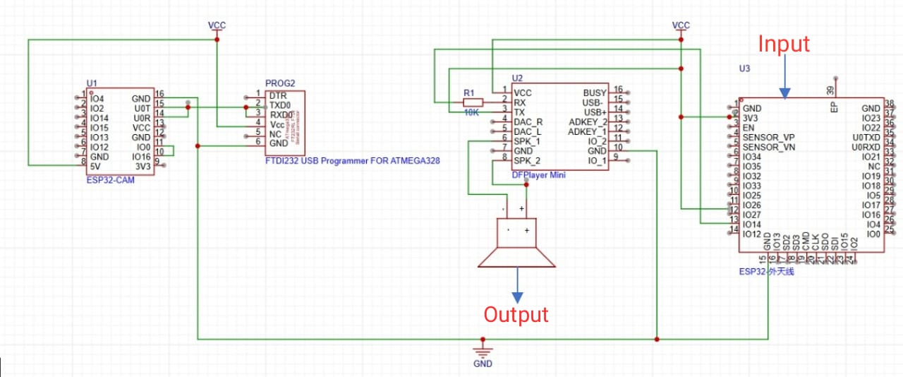
ALGORITHM

Slide 15
ARCHITECTURE

Slide 16
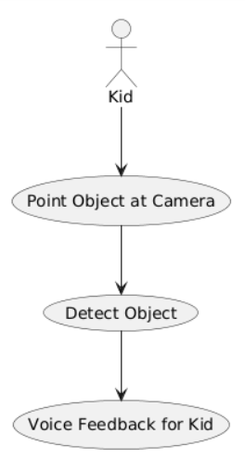
USE CASE DIAGRAM

Slide 17
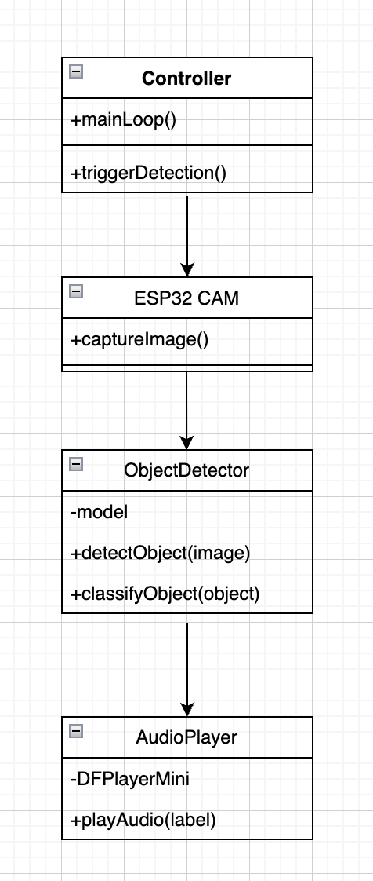
CLASS DIAGRAM

Slide 18
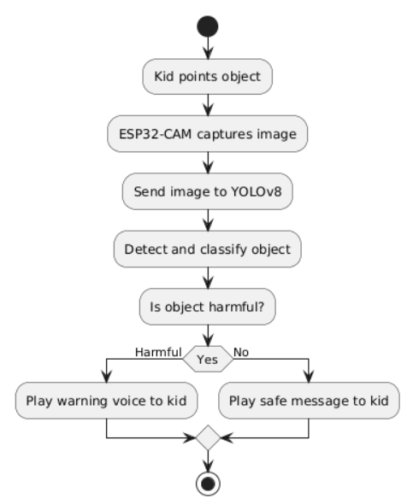
ACTIVITY DIAGRAM

Slide 19
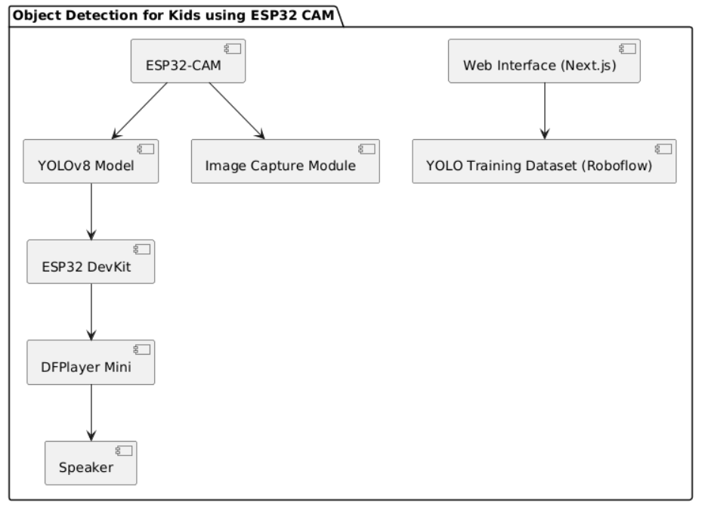
COMPONENT DIAGRAM

Slide 20
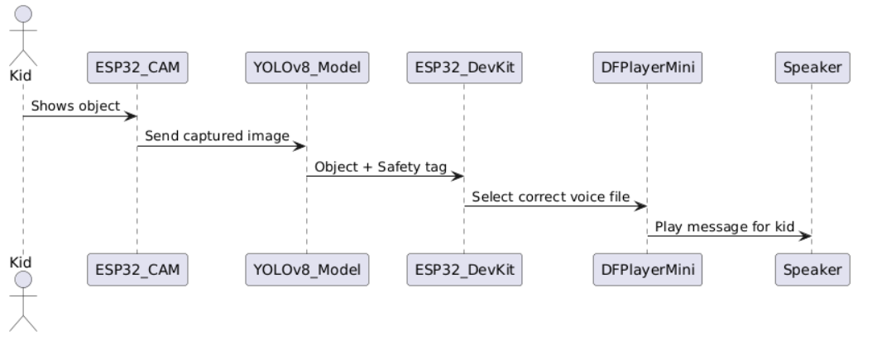
SEQUENCE DIAGRAM

Slide 21
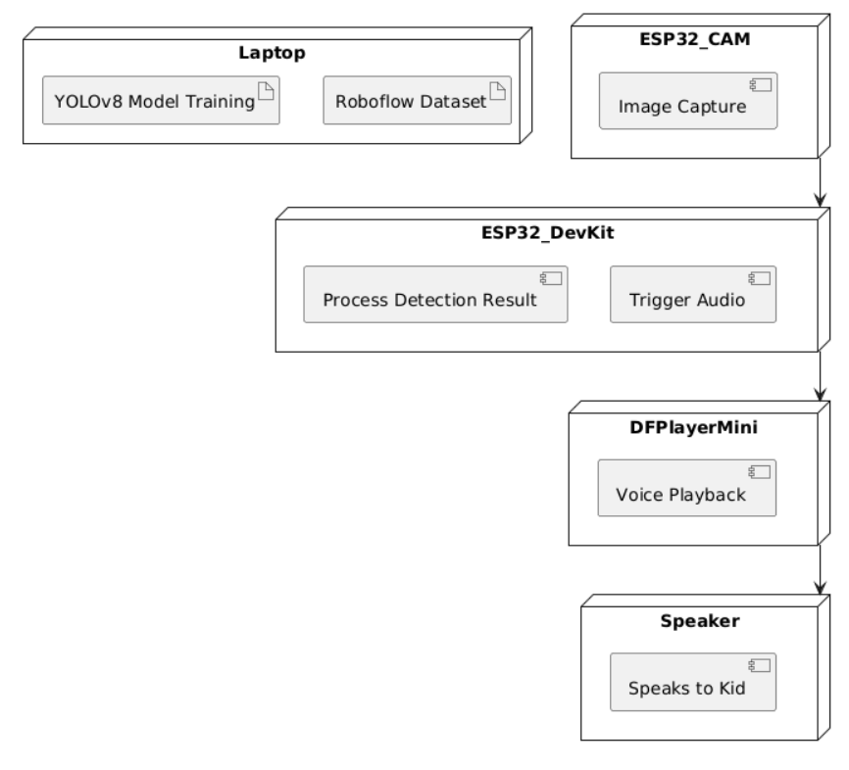
DEPLOYMENT DIAGRAM

Slide 22
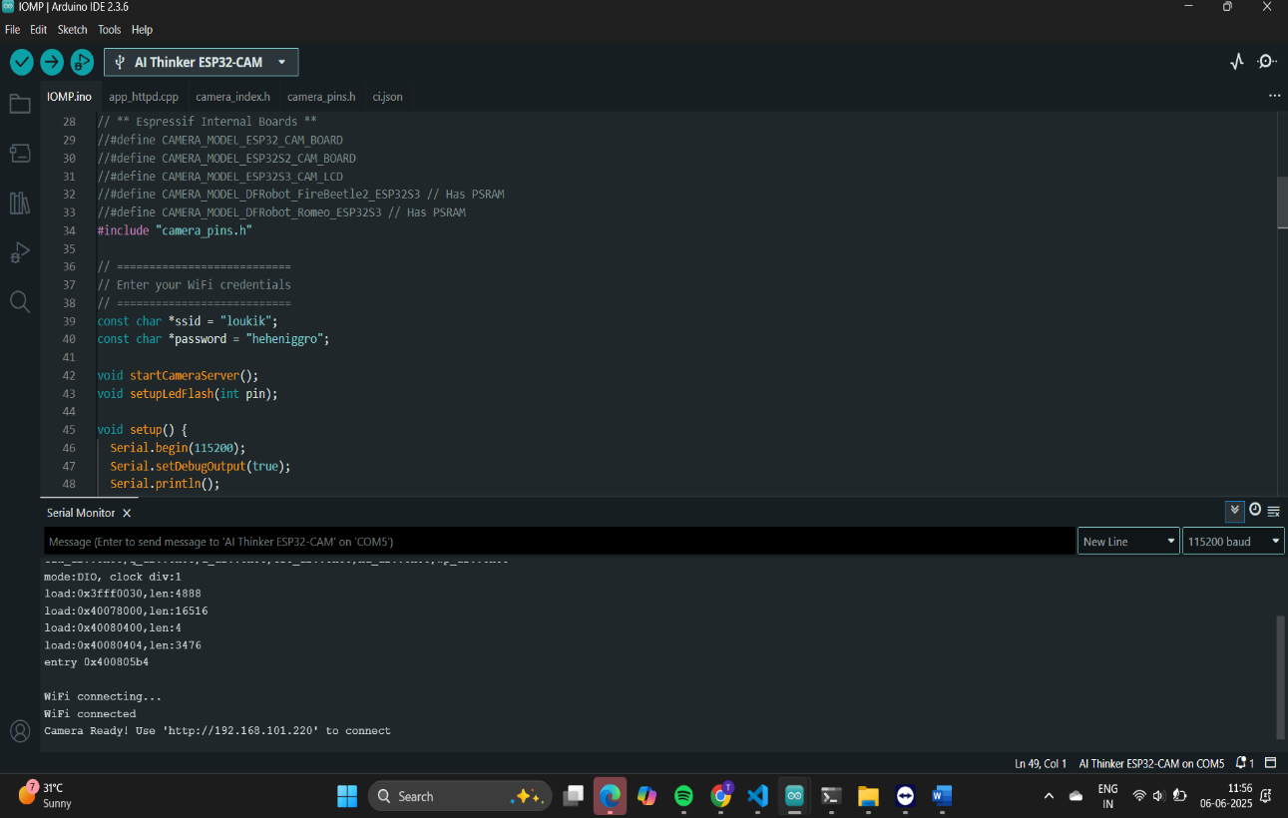
CODE IMPLEMENTATION AND OUTPUTS:

Slide 23
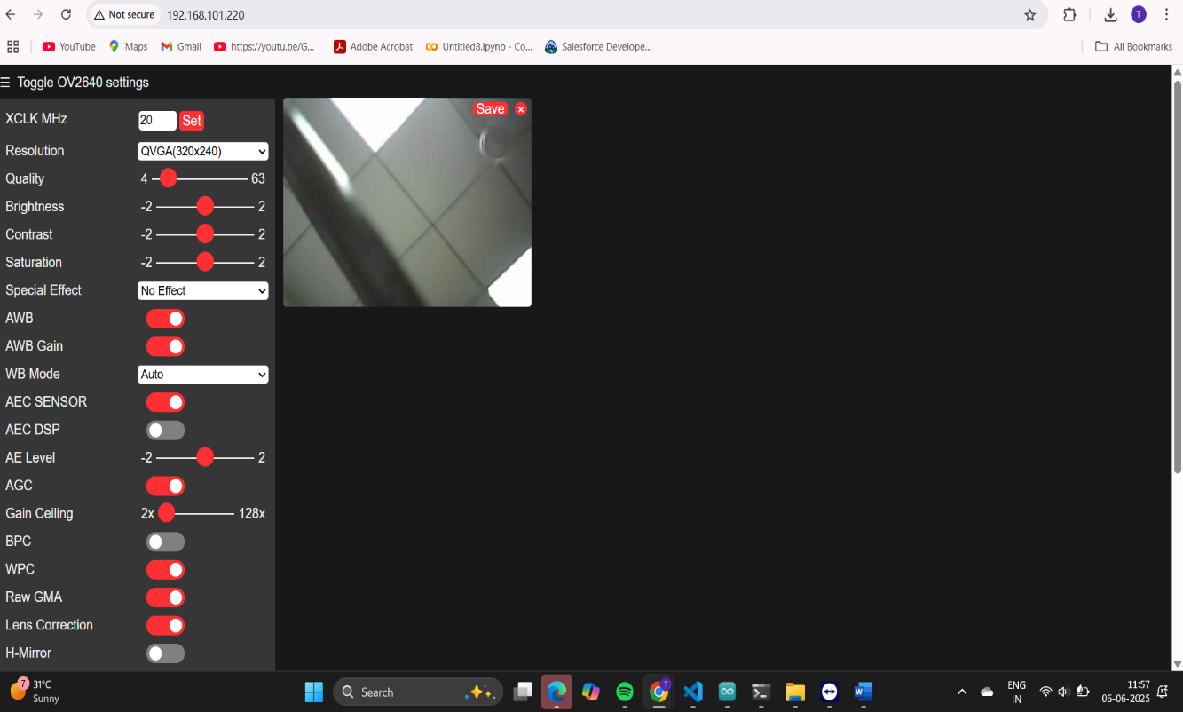

Slide 24
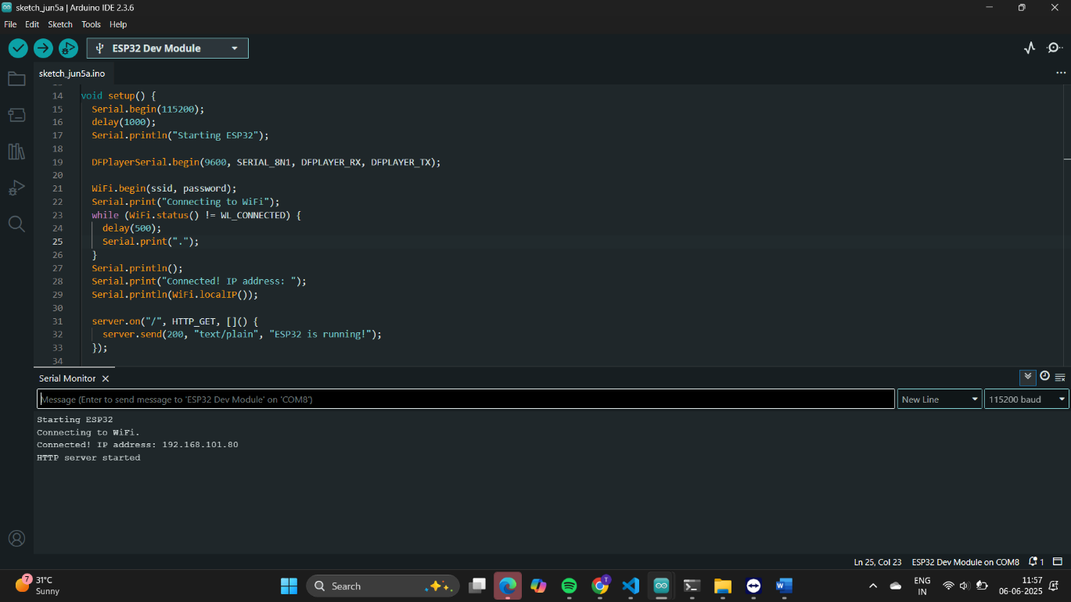

Slide 25


Slide 26
TEST CASES
 | Test Case Name | Test Description | Expected Output | Actual Output | Remarks
TC_01 | ESP32-CAM Power On | Power on the ESP32-CAM module | ESP32-CAM boots up and starts video streaming | ESP32-CAM boots up and starts video streaming | Success
TC_02 | WiFi Connection | ESP32-CAM connects to configured WiFi hotspot | ESP32-CAM successfully connects to WiFi | ESP32-CAM successfully connects to WiFi | Success
TC_03 | Video Streaming | Stream live video from ESP32-CAM to local server | Live video stream is visible on local server | Live video stream is visible on local server | Success
TC_04 | Object Detection | Run YOLOv8 detection on video frames | Objects are detected and labeled correctly | Objects are detected and labeled correctly | Success
TC_05 | Detection ID Send | Send detected object ID via HTTP from server to ESP32 DevKit | ESP32 DevKit receives correct object ID | ESP32 DevKit receives correct object ID | Success
TC_06 | Audio Playback | ESP32 DevKit plays corresponding audio via DFPlayer Mini | Correct audio clip plays matching detected object | Correct audio clip plays matching detected object | Success
TC_07 | Harmful Object Alert | Detect harmful object | Audio output warns child about harmful object | Audio output warns child about harmful object | Success
TC_08 | Harmless Object Info | Detect harmless object | Audio output gives simple, positive info | Audio output gives simple, positive info | Success
TC_09 | No Object Detected | No object in view | No audio played | No audio played | Success
TC_10 | System Reset | Reset device during operation | Device restarts without error | Device restarts without error | Success

Slide 27


Slide 28
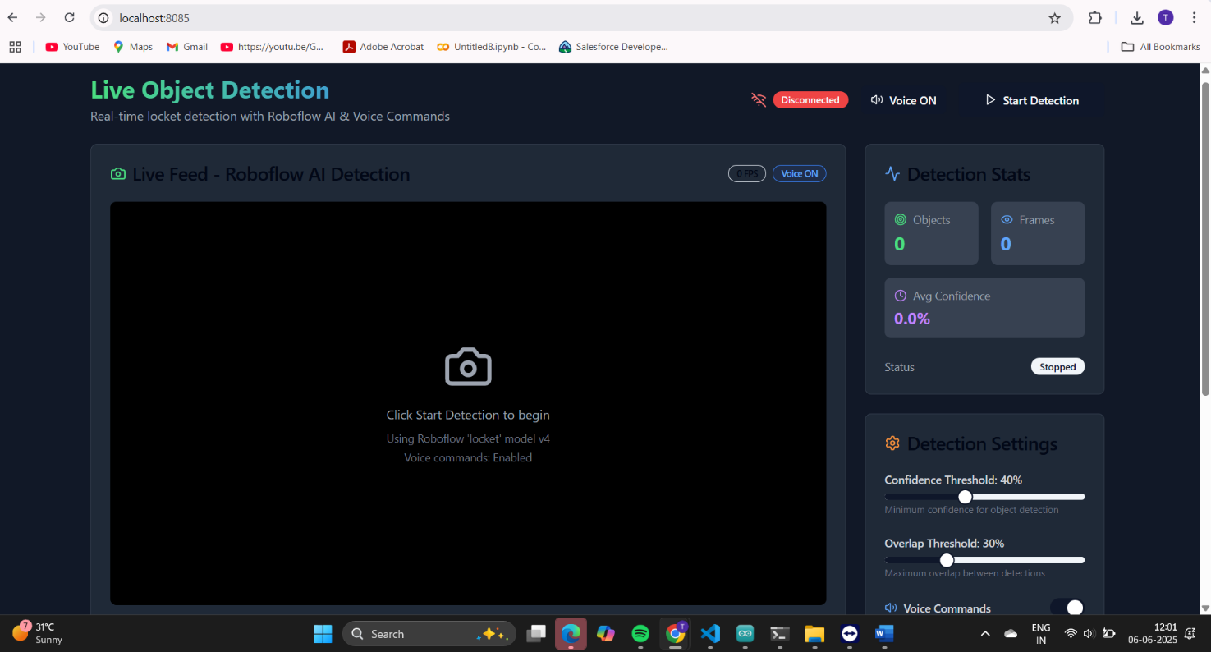


Slide 29
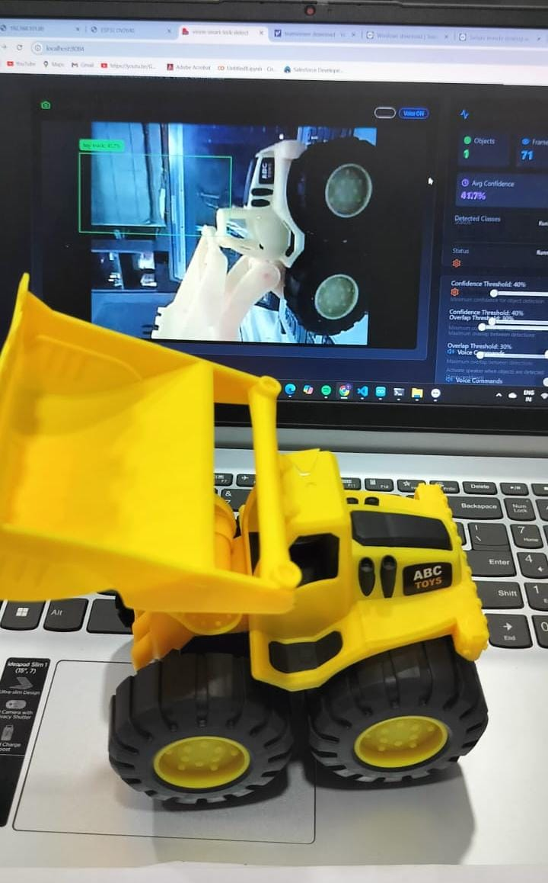

Slide 30
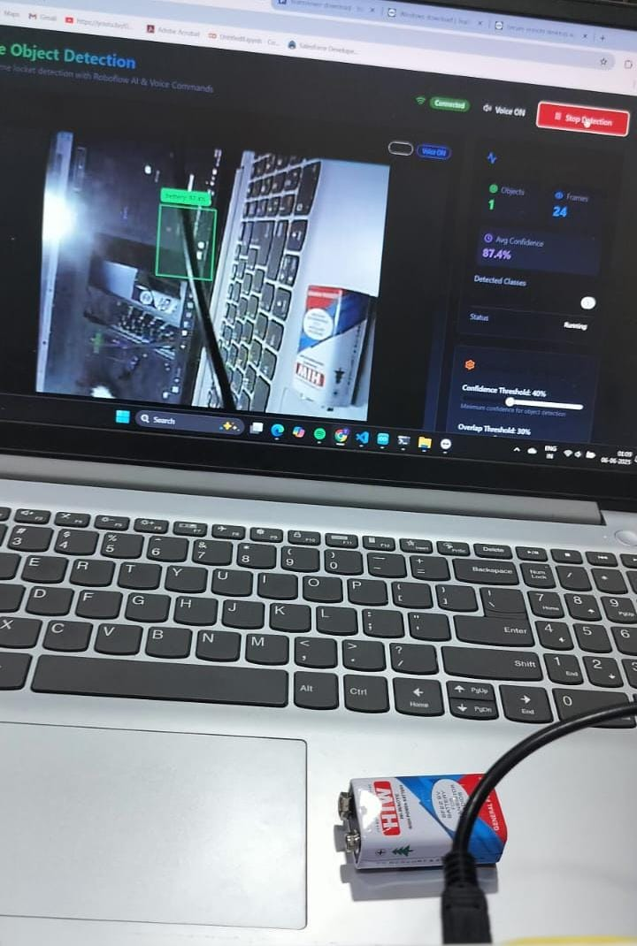

Slide 31
CONCLUSION AND FUTURE ENHANCEMENT
Conclusion:
The Object Detection Device for Kids using ESP32-CAM successfully demonstrates the integration of real-time object recognition and voice-based safety feedback using a lightweight, cost-effective, and fully offline system.
The device is designed with modularity in mind, separating the video capture and audio feedback tasks to overcome the memory constraints of the ESP32-CAM.
The system delivers clear voice alerts that guide children in understanding whether an object is safe or harmful, without requiring internet access, touchscreen input, or adult assistance.
The project meets its goals by offering a screen-free, intuitive, and child-friendly learning and safety tool. It functions efficiently in real-time and is easy to use in home, school, or daycare environments. The successful integration of ESP32-CAM, YOLOv8, ESP32 Devkit, and DFPlayer Mini demonstrates the potential of embedded AI in low-resource, educational applications.
Safe, cost-effective system for children

Slide 32
Future Scope:
Wearable Form Factor: Miniaturize and optimize the hardware layout to create a compact, wearable version of the device (e.g., as a smart badge or lanyard) for improved portability and usability.
Expanded Dataset: Increase the variety of detectable objects to include more household, classroom, and playground items, making the system more versatile in real-world use.
Dynamic Voice Feedback: Integrate offline text-to-speech (TTS) capabilities to eliminate the need for pre-recorded audio files and allow dynamic message generation.
Multi-Language Support: Add regional language options to make the device accessible in diverse linguistic settings.
Custom PCB Design: Replace the breadboard prototype with a printed circuit board (PCB) to improve stability and prepare the device for large-scale use.
Wearable Form Factor: Miniaturize and optimize the hardware layout to create a compact, wearable version of the device (e.g., as a smart badge or lanyard) for improved portability and usability.
Expanded Dataset: Increase the variety of detectable objects to include more household, classroom, and playground items, making the system more versatile in real-world use.
Dynamic Voice Feedback: Integrate offline text-to-speech (TTS) capabilities to eliminate the need for pre-recorded audio files and allow dynamic message generation.

Slide 33
REFERENCES
[1] Zhang, Wei, et al. "Lightweight CNN for object detection on embedded devices." IEEE Sensors Journal (2024).
[2] Kumar, R., and P. Sharma. "ESP32-CAM based offline object detection with audio feedback." 2024 IEEE International Conference on Embedded Systems (ICES), 2024.
[3] Banerjee, A., and R. Paul. "Audio-Assisted Object Identification System for Pre-School Children." Journal of Educational Technology & Society 26.1 (2023): 35–44.
[4] Kadhim, Thair A., et al. "A face recognition application for Alzheimer’s patients using ESP32- CAM and Raspberry Pi." Journal of Real-Time Image Processing 20.5 (2023): 100.
[5] Vinod, Sredha, et al. "Object detection using ESP32 cameras for quality control of steel components in manufacturing structures." Arabian Journal for Science and Engineering 48.10 (2023): 12741–12758.
[6] Ramesh, S., and S. Ramya. "Object Detection using Embedded Deep Learning on Microcontrollers for Safety Systems." International Journal of Engineering Research & Technology (IJERT) 11.5 (2022): 211–215.
[7] Chen, X., et al. "Real-time Object Detection and Notification System for the Visually Impaired using Raspberry Pi and YOLOv3." Procedia Computer Science 184 (2021): 564–571.
[8] Sharma, V., and R. Kaur. "Smart Safety Alert System using Computer Vision for Children at Home." International Journal of Innovative Research in Computer and Communication Engineering 9.4 (2021): 1452–1458.
[9] Ali, T., et al. "Lightweight Object Recognition System using CNN on ESP32 for IoT Applications." IEEE Access 8 (2020): 170304–170316.
[10] Dionisi, Alessandro, Emilio Sardini, and Mauro Serpelloni. "Wearable object detection system for the blind." 2012 IEEE International Instrumentation and Measurement Technology Conference Proceedings. IEEE, 2012.
.

Slide 34
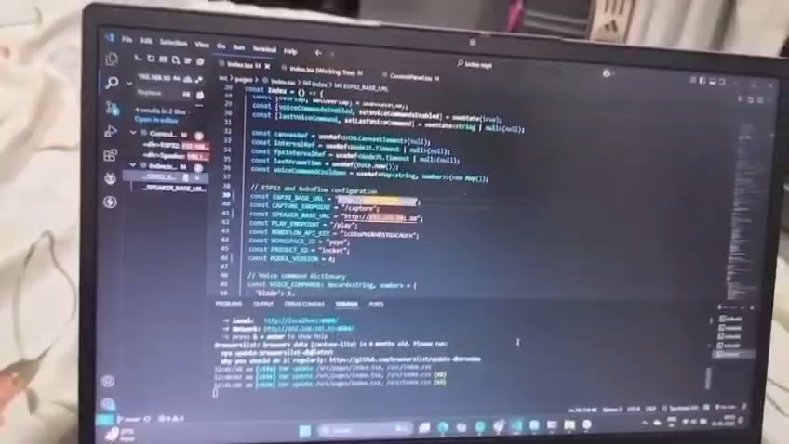

Slide 35
THANK YOU

